Slide 1

Speech Enhancement Using U-Net with Compressed Sensing
Submitters:
Avihay Hadad
Elad Fisher
24-1-R-11
Supervisors:
Prof. Zeev Volkovich
Dr. Renata Avros

Slide 2
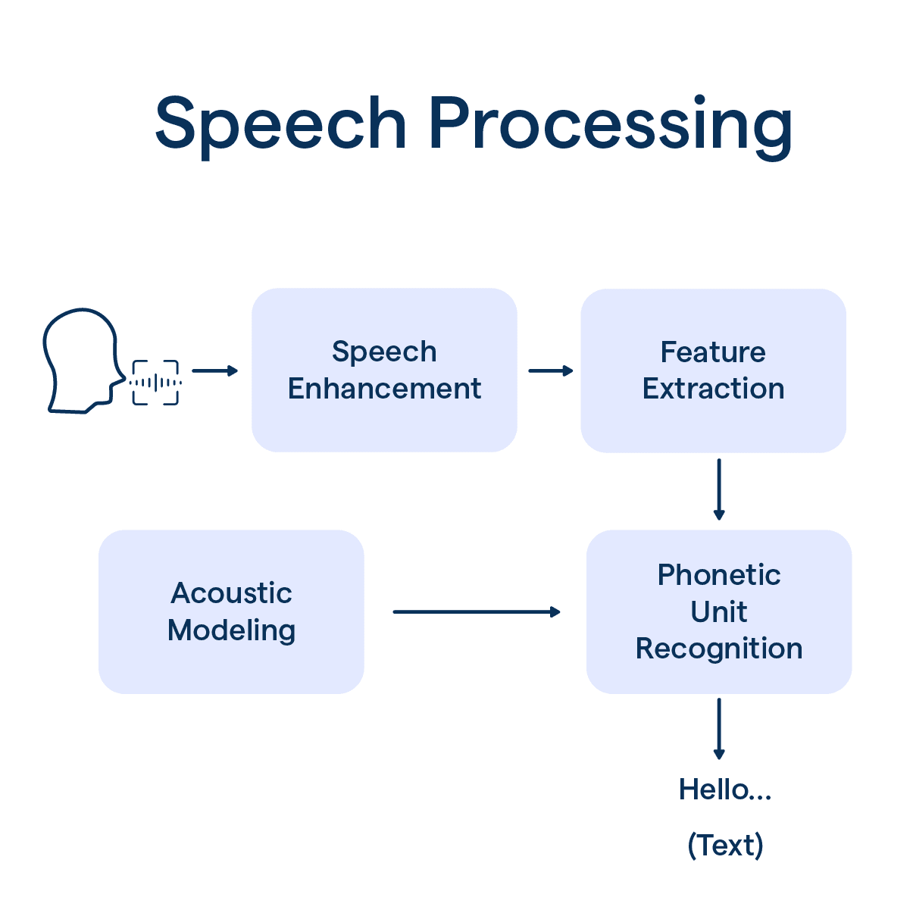
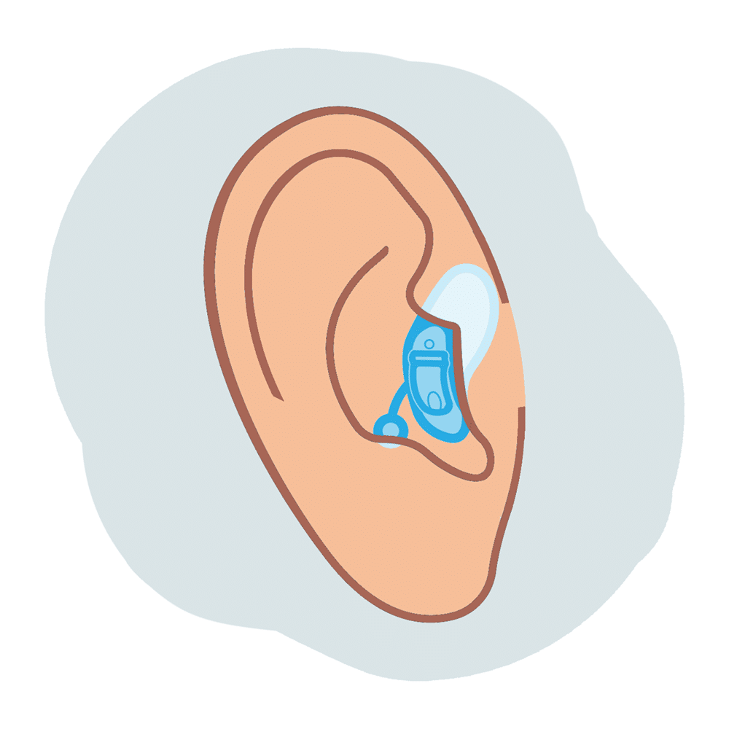

Speech Enhancement: Background
Speech enhancement is very important in the field of speech enhancement processing.
The goal is to improve the quality and intelligibility of speech which is disturbed by external noises.
Used in various applications:
Speech Recognition
Mobile Communications
Hearing Aids
- 1 -

Slide 3
Main Purposes
Distinguishing the differences between speech and noise.
Denoising or filtering the noise.
Enhancing the speech features.
- 2 -
Notes:
False Negative – I was wrong (false) when I said Negative

Slide 4
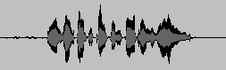
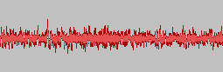
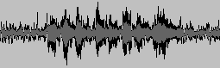
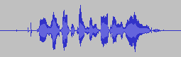
Suggested Solution
A time-domain U-Net model combining lightweight Shuffle Attention mechanism and Compressed Sensing loss
The main idea is to apply the architecture of U-Net to speech enhancement, while using CS (Compressed Sensing) loss to improve the quality and clarity of the enhanced speech.
+
Clean Speech
=
Noise
The Model
Noisy Speech
Enhanced Speech
- 3 -
Notes:
False Negative – I was wrong (false) when I said Negative

Slide 5
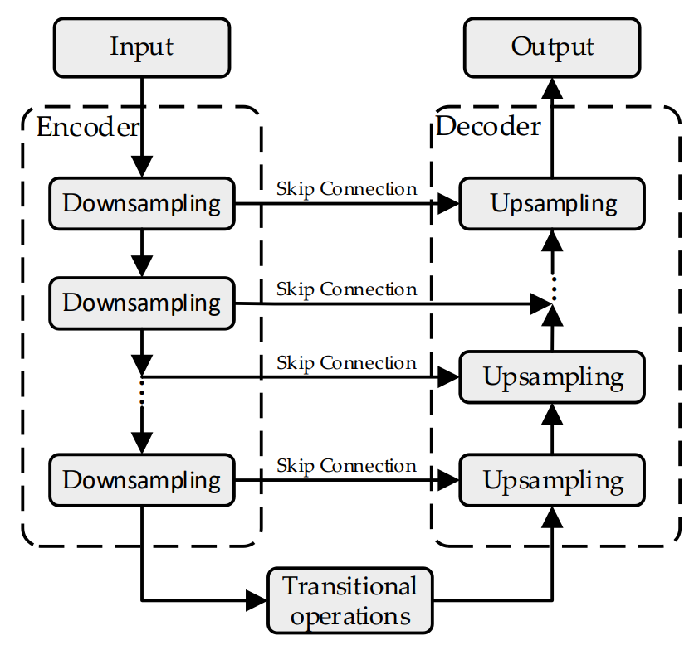
U-Net: Background
A model that has equal number of layers in both encoder & decoder that uses convolutional blocks.
Pays attention to the speech contextual information and prevent the detailed features from being lost during down-sampling or up-sampling.
- 4 -

Slide 6
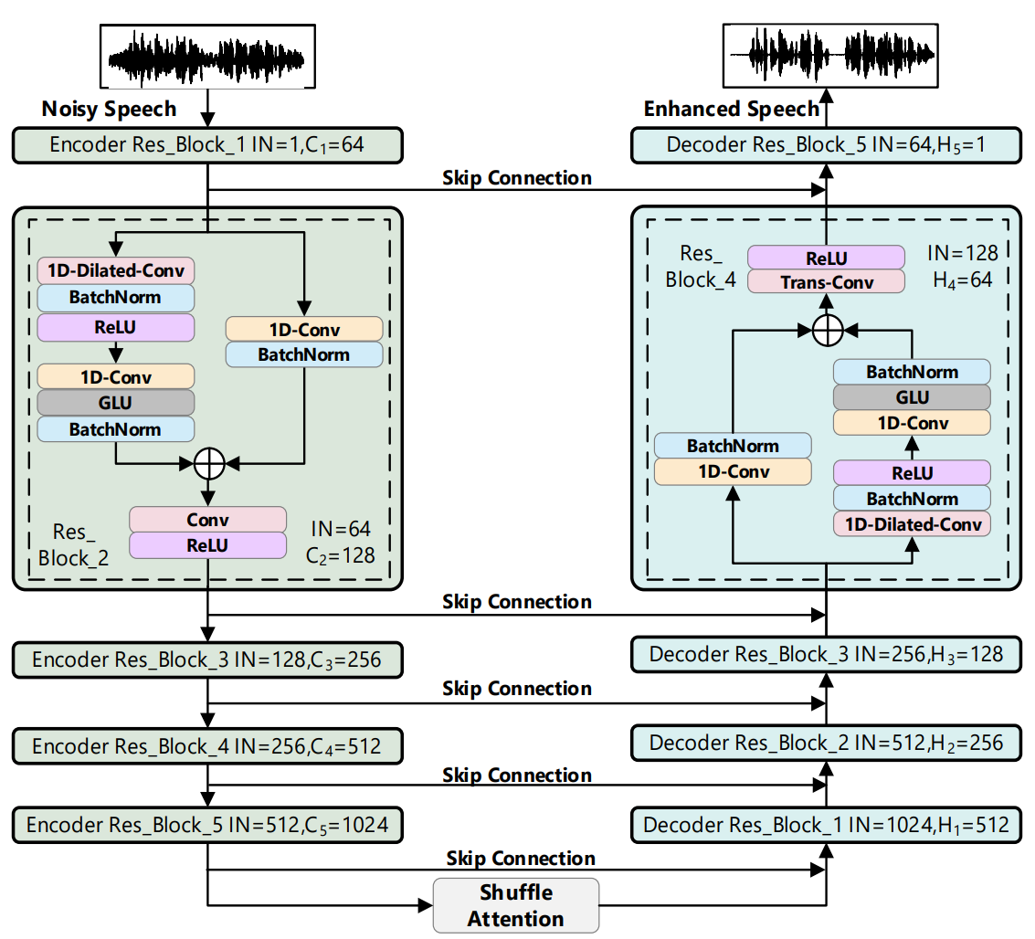
Suggested Model Workflow
+
Clean Speech
=
Noise
Traditional U-Net
Inherit
- 5 -

Slide 7
Our Solution
A time-frequency domain U-Net model based on TensorFlow and Keras, with a custom loss function
The main idea is to apply the architecture of U-Net to speech enhancement, while combining clean speech data from the RAVDESS dataset with noise from the UrbanSound8K dataset.
White(Gaussian) + Urban
+
Clean Speech
=
Noise
The Model
Noisy Speech
Enhanced Speech
- 6 -
Notes:
False Negative – I was wrong (false) when I said Negative

Slide 8
Our Model Workflow
+
Clean Speech
=
Noise
Traditional U-Net
Encoder Block
Decoder Block
Inherit
Conv2D
Conv2D
BatchNorm
BatchNorm
SpatialDropout2D
Conv2D
Conv Block
BatchNorm
Conv2D
BatchNorm
Concatenate
Trans-2D-Conv
MaxPooling2D
- 7 -
Conv Block

Slide 9



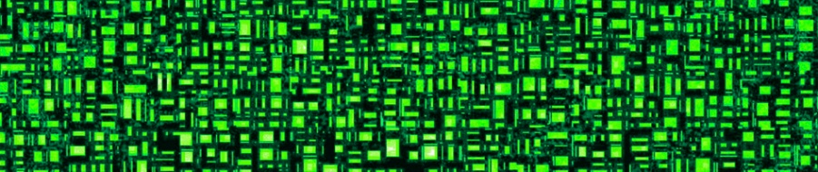



Our Solution: Implementation
Our solution was developed and integrated with the following:
Datasets
Urban_Sound_8k
Choir_Sound_8k
ravdess_8k
- 8 -
Notes:
False Negative – I was wrong (false) when I said Negative

Slide 10
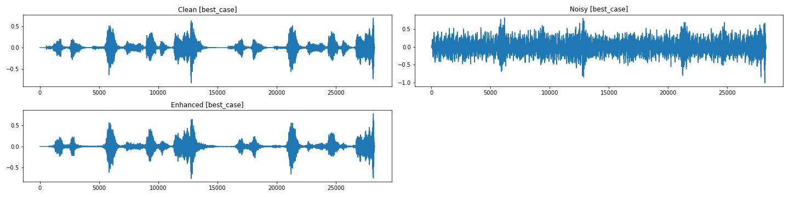
Model Achievements
The criteria that we set for the succession of the model were:
✔
Ability to distinguish the differences between speech and noise.
Denoising or filtering the noise.
Enhancing the speech features.
✔
✔
Real Output
- 9 -
Notes:
False Negative – I was wrong (false) when I said Negative

Slide 11
Model Evaluation
Evaluating the performance of the model mainly with PESQ & SNR
The PESQ (Perceptual Evaluation of Speech Quality) metric is widely used in the industry as an automatic way to measure speech quality. (Ranges between [-0.5, 4.5])
Sound-To-Noise Ratio (SNR) is the ratio between the desired signal (speech) against the undesired signal (noise).
We also conducted a listening test of the output sounds (clean, noisy, and corrected).
- 10 -

Slide 12


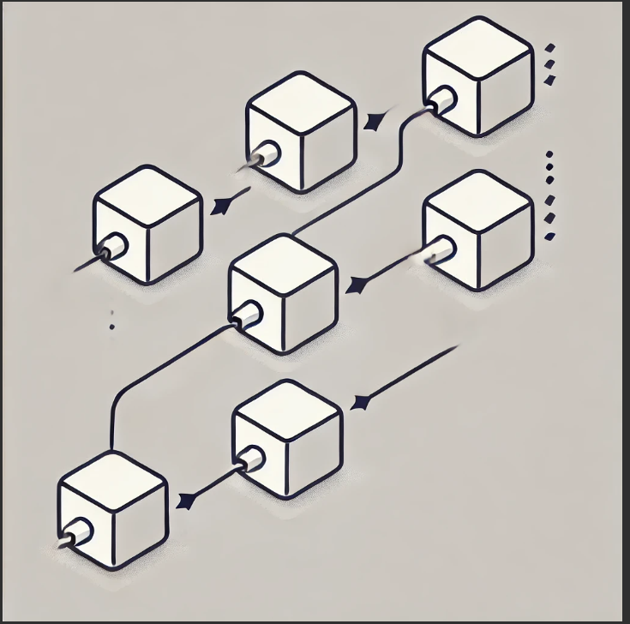

Experiments
We performed few experiments to assess the application limit of the model
Numerical Study
Simultaneous Multiple Speakers / Choir
Noiseless audio
Cascaded Modeling
Iterative Denoising
- 11 -

Slide 13
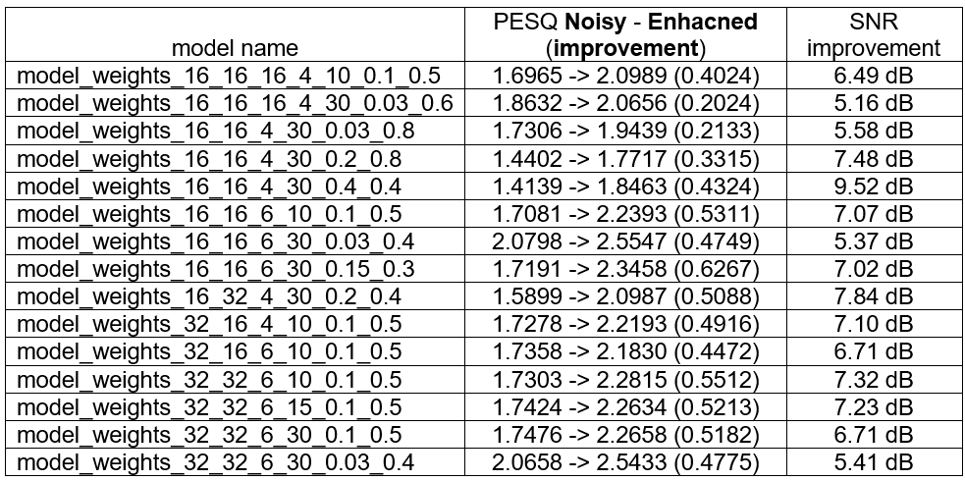
Numerical Study: Evaluation Results
model_weights_batch_filters_layers_epochs_white_urban
- 12 -

Slide 14

Experiments: Simultaneous Multiple Speakers
Clean
- 13 -

Slide 15

Experiments: Simultaneous Multiple Speakers
Noisy
- 14 -

Slide 16
Experiments: Simultaneous Multiple Speakers
Denoised
- 15 -

Slide 17

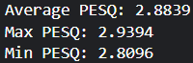
Experiments: Noiseless audio
“Noisy”
“Denoised”
Overall Statistics of “denoising” multiple noiseless audio
- 16 -

Slide 18
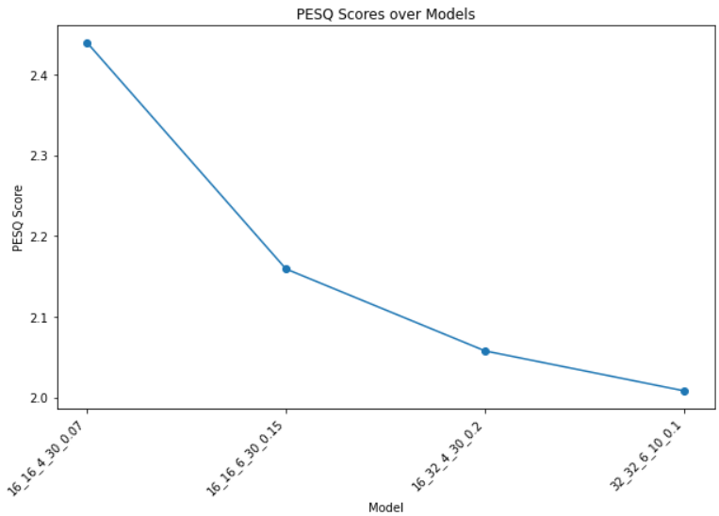
Experiments: Cascaded Model
The noisy sound was passed through a sequence of models, where each model's output was used as input for the next, aiming to incrementally improve the speech quality.
Quality is decreased
Clean
Final Output
- 17 -

Slide 19
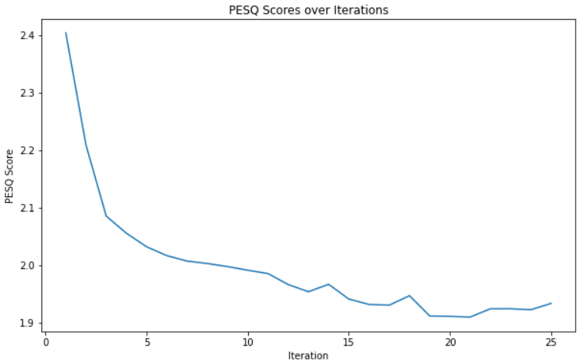
Experiments: Iterative Denoising
Passing the speech signal through multiple models in sequence. Each model progressively refining the output to reduce noise.
Quality is decreased
Clean
Noisy
Denoised
- 18 -

Slide 20
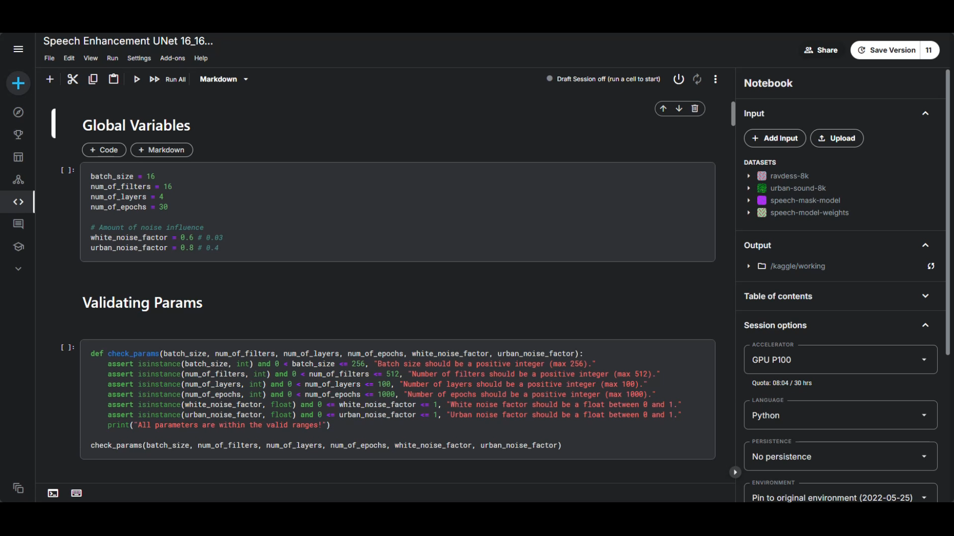
Demonstration
- 19 -

Slide 21
Testing Process
Test ID | Module | Description | Expected Result
1 | Global Variables | Insert value for the variable batch_size. | Batch size should be a positive integer (max 256).
2 | Model Creation | Insert value for the variable dropout_type. | dropout_type must be one of ['spatial', 'standard']
3 | Model Creation | Create the UNet model using the defined global variables | Model was created with the predefined global variables.
4 | Cascading | Choose 3 different models for the cascading process. | Chosen models for cascading_denoise should be different from each other.
5 | Iterative Denoising | Insert value for the variable num_iterations. | num_iterations should be a positive integer (max 100).
6 | Run Experiments | Run All Experiments available. | Experiment results for analysis are saved in a desired output directory in Kaggle.
- 20 -

Slide 22
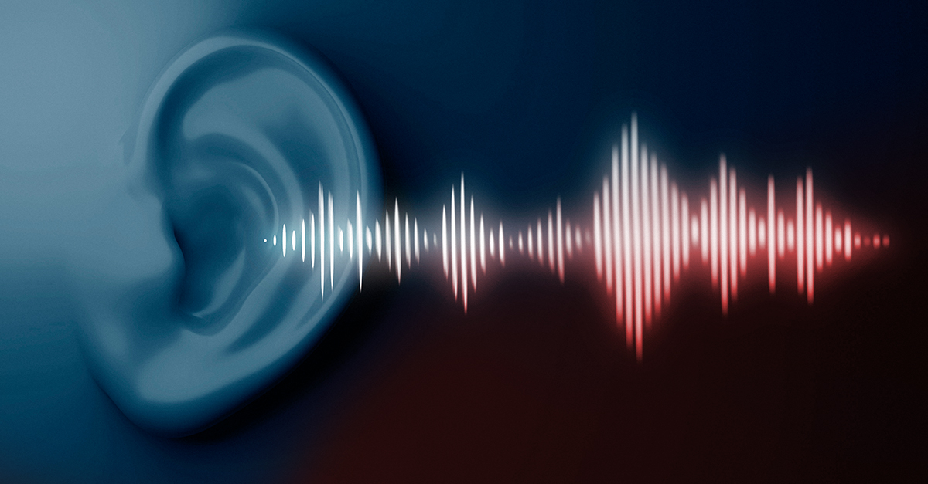
Thanks for your attention!
Elad Fisher
Avihay Hadad

Slide 23
Backup
- 21 -

Slide 24

Experiments: Simultaneous Multiple Speakers (2)
- 22-

Slide 25
Experiments: Simultaneous Multiple Speakers (2)
Noisy
Denoised
- 23 -

